Slide 1
Digitalization of E2E Bioprocess
Overview of Agile Fundamentals
Sudheer Ram E
Last updated: November, 2016

Slide 2
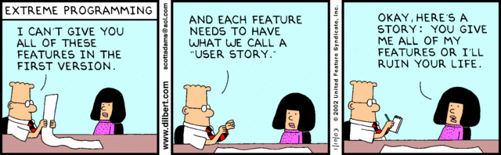

Slide 3
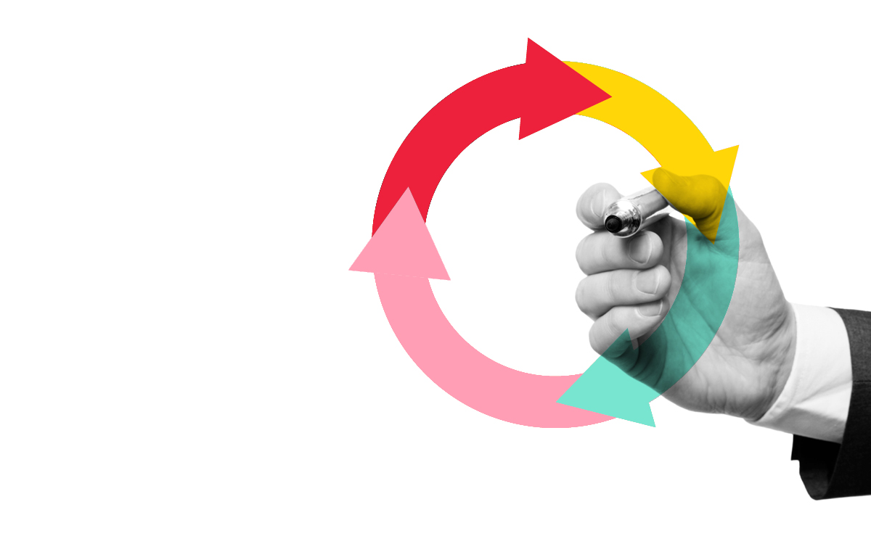
Agenda
What is Agile – Scrum
Agile Manifesto
Agile Values
Key Characteristics
Agile Manifesto
Sprint Flow
The Backlog
The Iceberg
User Story
INVEST Principle
Sample User Story
Scrum Framework
Roles
Ceremonies
Artifacts
Definition of Done
Estimation
Testing in Agile
Glossary of Terms

Slide 4
Values & Principes

Slide 5

We are losing the relay race....
“The… ‘relay race’ approach to product development…may conflict with the goals of maximum speed and flexibility. Instead a holistic or ‘rugby’ approach—where a team tries to go the distance as a unit, passing the ball back and forth—may better serve today’s competitive requirements.”
Hirotaka Takeuchi and Ikujiro Nonaka, “The New New Product Development Game”, Harvard Business Review, January 1986.

Slide 6
What is Agile?
Agile is simple (not easy)
Doing the important things first - (Highest Business Value)
It’s about people, values, principles and practices
Focused on team communication
regularly delivering value through working software
rapidly and repeatedly inspect actual working software
.

Slide 7
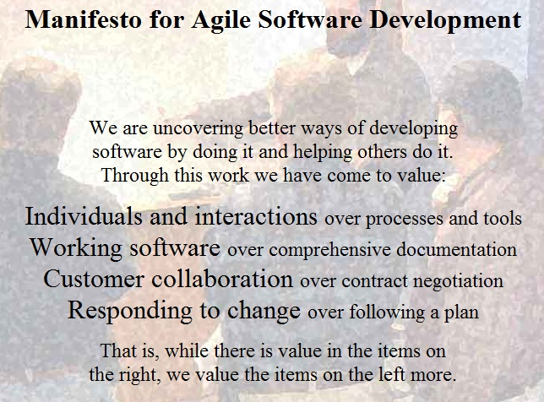

Slide 8

Agile Manifesto – The twelve Principles
Our highest priority is to satisfy the customer through early and continuous delivery of valuable software.
Welcome changing requirements, even late in development. Agile processes harness change for the customer's competitive advantage.
Deliver working software frequently, from a couple of weeks to a couple of months, with a preference to the shorter timescale.
Business people and developers must work together daily throughout the project.
Build projects around motivated individuals. Give them the environment and support they need, and trust them to get the job done.
The most efficient and effective method of conveying information to and within a development team is face-to-face conversation.
Working software is the primary measure of progress.
Agile processes promote sustainable development. The sponsors, developers, and users should be able to maintain a constant pace indefinitely.
Continuous attention to technical excellence and good design enhances agility.
Simplicity--the art of maximizing the amount of work not done--is essential.
The best architectures, requirements, and designs emerge from self-organizing teams.
At regular intervals, the team reflects on how to become more effective, then tunes and adjusts its behavior accordingly.

Slide 9


Agile Values
Values are the foundation for all the activities and artifacts for a project following an Agile methodology.
Agile Values
Commitment – the team committing to deliver functionality to the business by or before the end of their time box or quoted cycle time
Courage – the courage to speak up even when a situation becomes uncomfortable
Respect – treat individuals & organizations with respect
Openness – working in a way that issues, risks, successes & failures are open to peers and management
Focus – on the critical path
Scrum Values
Transparency – all work is performed in a transparent manner
Inspection – review the team’s performance and their process at cadence checkpoints
Adaptation – make adjustments to improve team performance or streamline the process
XP Values
Trust – between team members, between the team and the business, between the team and management
Simplicity – focus on the simplest design first and iterate to increase complexity
Feedback – seek out feedback from stakeholders and end users frequently

Slide 10
Agile /Scrum

Slide 11
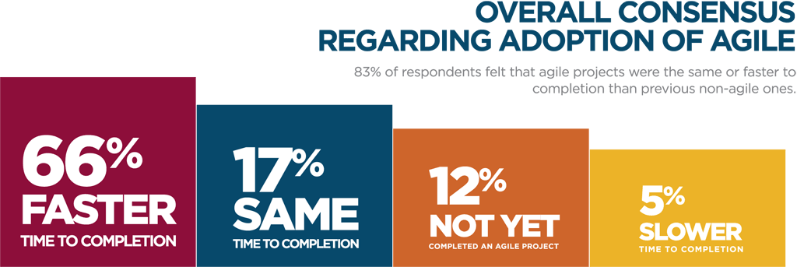
Comparison
Average Project:
Agile Project:
30% Success ratio
60-80% Success Ratio

Slide 12

Project noise levels..
Source: Strategic Management and Organizational Dynamics by Ralph Stacey in Agile Software Development with Scrum by Ken Schwaber and Mike Beedle.
Far from
Agreement
Complex
Anarchy
Requirements
Complicated
Close to
Agreement
Simple
Technology
Close to
Certainty
Far from
Certainty

Slide 13

Agile Critical Success Factors
Management Buy-In
Change Organizational Structure and Design
Top Down Approach
Participation from Customer
Appropriate infrastructure
Change In Mindset

Slide 14

Key Agile Management Practices
Daily Stand-up
Iteration planning
Release planning
Prioritized backlog
Retrospectives
Onsite customer satisfaction
Story wall
Pair programming
Open workspaces
Showcase/demo

Slide 15

Key Agile Engineering Practices
Unit testing
Continuous integration
Frequent check-ins
Test driven development
Automated acceptance testing
Continuous refactoring
Evolutionary design

Slide 16

Concerns With Agile Adoption
Opposition to change/cultural shift
Lack of coaching/Help in adoption
Lack of quality people
Perception of less documentation
Perceived loss of management control
Perception that agile does not scale
Lack of management buy-in
Perception that agile reduces quality

Slide 17
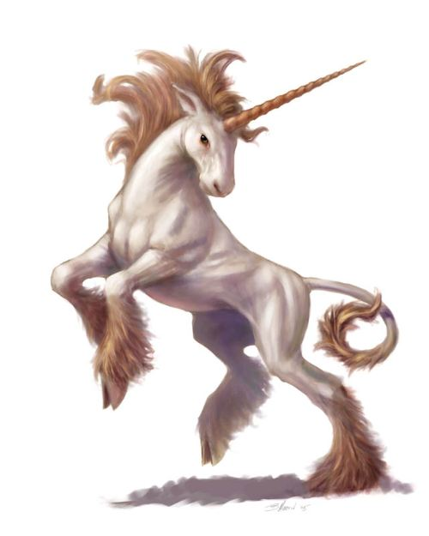
Myths And Misconceptions
New
A silver bullet
A solution to resource issues
Without planning, documentation, architecture
A license to hack
An excuse for poor quality, upfront design
Not Disciplined
No fixed price contracts
No project manager
No distributed teams

Slide 18

Factors Influencing Agile Adoption
Adapting to changing requirements
Improving time to market
Improving quality
Increasing productivity
Improve success ratio
Improving collaboration between business and IT
Reducing cost of software development
Improve project visibility
Fixing problems in existing process
Empowering teams
Customers asked for it

Slide 19

Key characteristics..
Self-organizing teams
Product progresses in a series of month-long “sprints”
Requirements are captured as items in a list of “product backlog”
No specific engineering practices prescribed
Uses generative rules to create an agile environment for delivering projects
One among the “agile“ process.

Slide 20
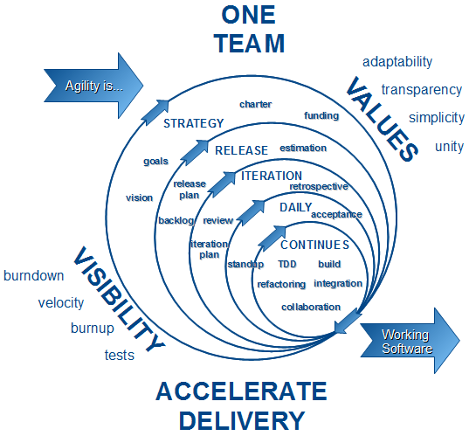
What is Agile? - Infographic

Slide 21
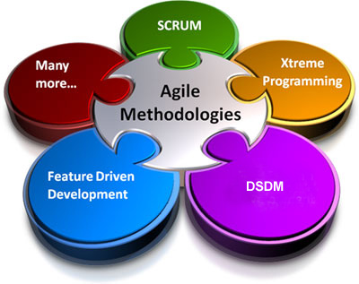
Agile Methodologies
Scrum
Extreme Programming(XP)
Lean
KANBAN
Crystal
Feature Driven Development(FDD)
Rational Unified Process(RUP)
Dynamic Systems Development Model(DSDM)
Scaled Agile Framework (SAFe)
Disciplined Agile Delivery(DAD)
Large Scale Scrum(LeSS)

Slide 22
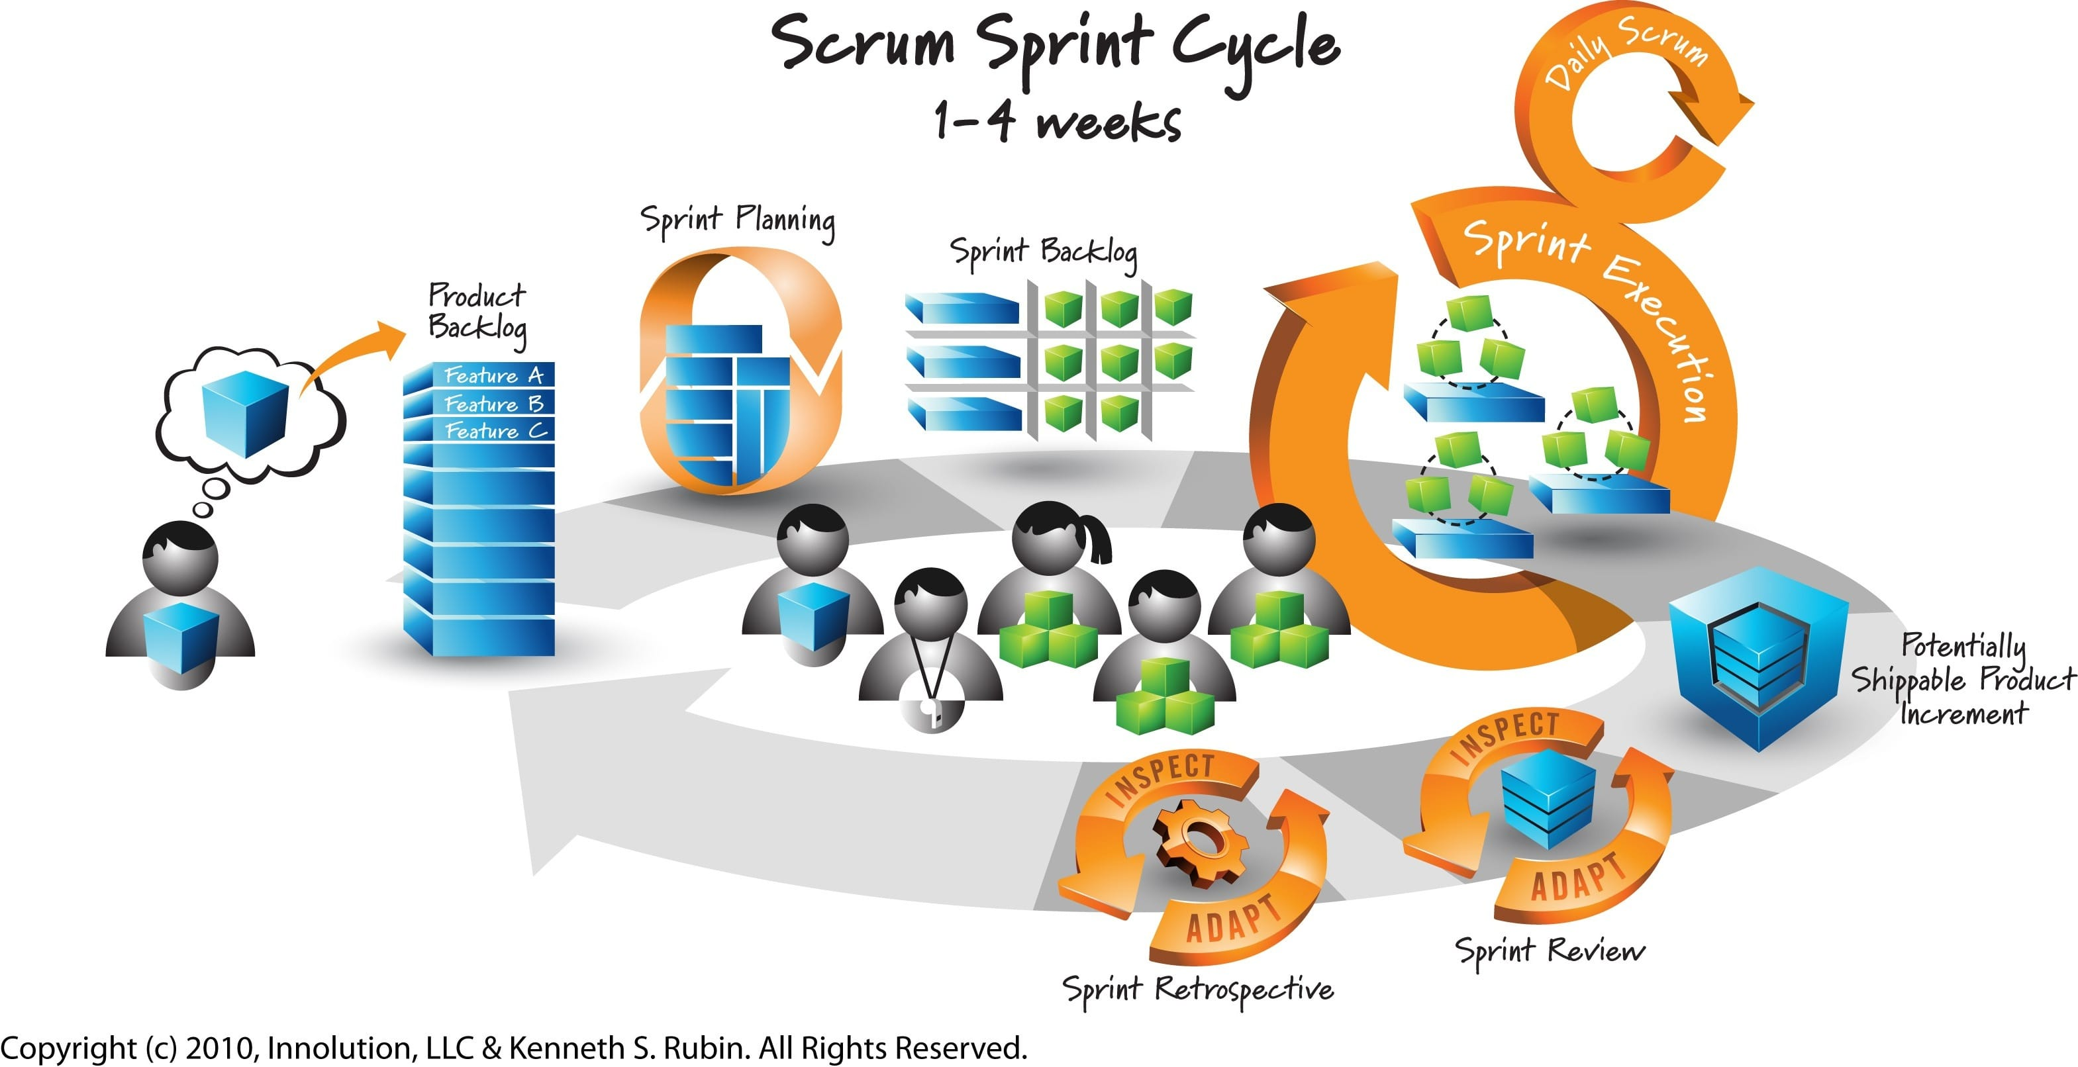
Scrum flow of activity

Slide 23
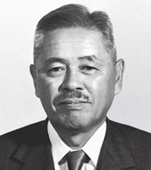
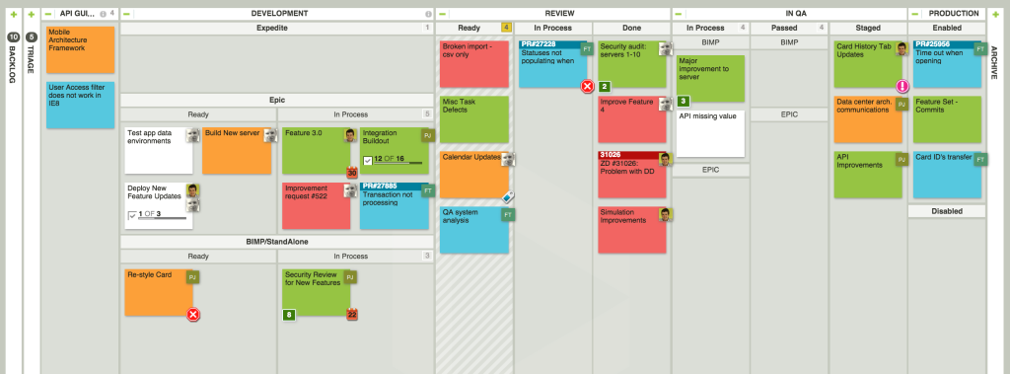
KANBAN System Taichii Ohno
All Work is visualized
Tasks Move from Left>Right = Pull
Team Self Organizes
Team Redesigns the board regularly

Slide 24
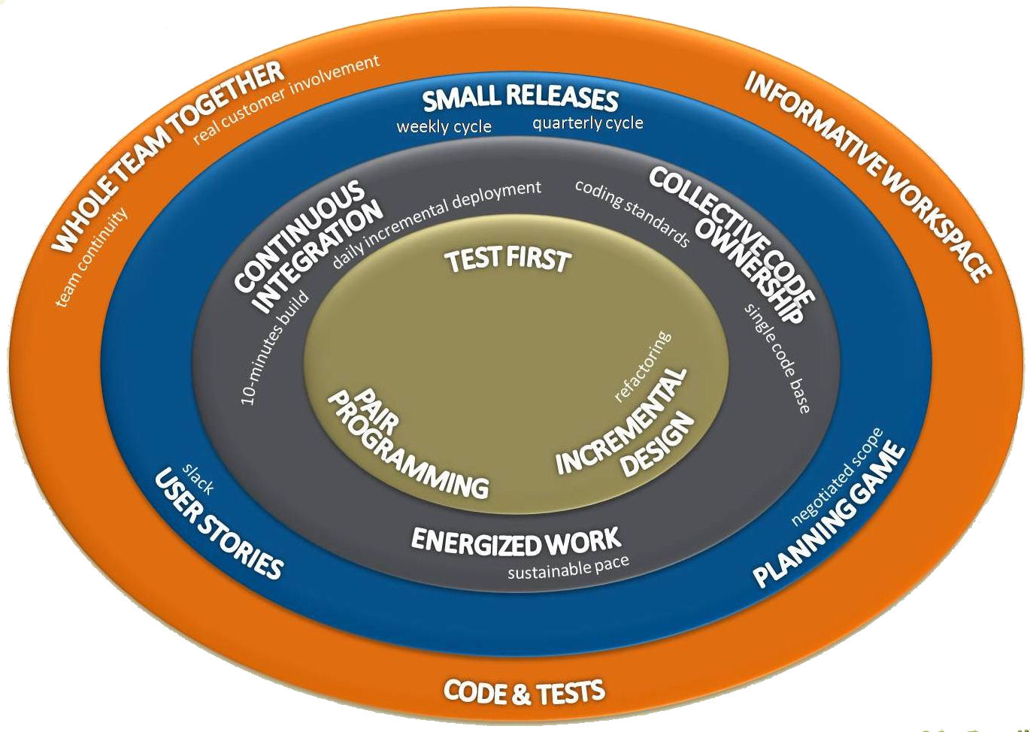
XP Core Practices
Pair programming
Planning game
Test-driven development
Continuous process / Continuous integration
Refactoring or design improvement
Shared understanding
Coding standards
Collective code ownership
Simple design
System metaphor
Programmer welfare
Sustainable pace
The customer is always available
Code the unit test first
Leave optimization until last
No overtime
All code must have unit tests
Acceptance tests are run often and the results are published

Slide 25

Sequential VS Overlapping development
Requirements
Design
Code
Test
Rather than doing all of one thing at a time...
...Scrum teams do a little of everything all the time
Source: “The New New Product Development Game” by Takeuchi and Nonaka. Harvard Business Review, January 1986.

Slide 26
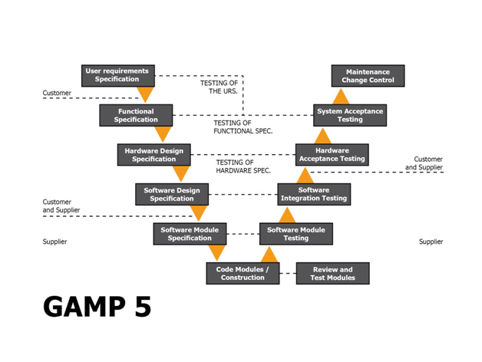
GAMP®5 V Model
Good Automation Manufacturing Practice
Architectural Diagram (AD) - ACS architecture diagram
Control System Strategy (CSS) - the system strategy. This strategy is mandatory to control the User Requirement Specification (URS) - customer requirements.
Functional Requirement Specification (FRS) - functional system requirements. She describes how the supplier will meet the requirements set out in the URS.
Logic Description (LD) - logical and other diagrams, function blocks, describing the process (it is important to mention that GAMP is designed for group (the batch processes)
Software Standards Document (SSD) - specifies requirements for the design and implementation of software.

Slide 27
Highest Priority – Early And Continuous Delivery Of Software
Release 1
Design
Develop
Release 2
Design/Refactor
Develop
Release 3
Design/Refactor
Develop
Deploy
Deploy
Deploy
Third increment
Second increment
First increment
Each increment is a piece of working software

Slide 28
Welcome Changing Requirements Even Late In Development
change in requirements
Release 1
Design
Develop
Release 2
Design/Refactor
Develop
Release 3
Design/Refactor
Develop
Deploy
Deploy
Deploy
Third increment
Second increment
First increment

Slide 29
Deliver Working Software Frequently
Release 1
Design
Develop
Release 2
Design/Refactor
Develop
Release 3
Design/Refactor
Develop
Deploy
Deploy
Deploy
Third increment
Second increment
First increment
delivery of working software regularly

Slide 30
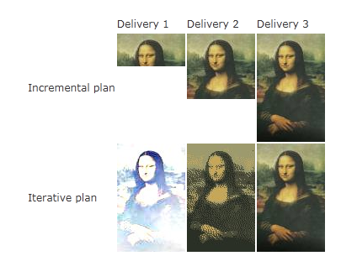
Be Iterative & Incremental
In the incremental plan, you don’t learn by the previous work, and the final product is not based on knowledge acquired during the journey
The difference between an incremental approach and an iterative approach is that the incremental approach does not require going back and changing things that are already delivered; the focus is only the requirements that have not yet been implemented.
.

Slide 31
SAFe Framework The Big Picture

Slide 32
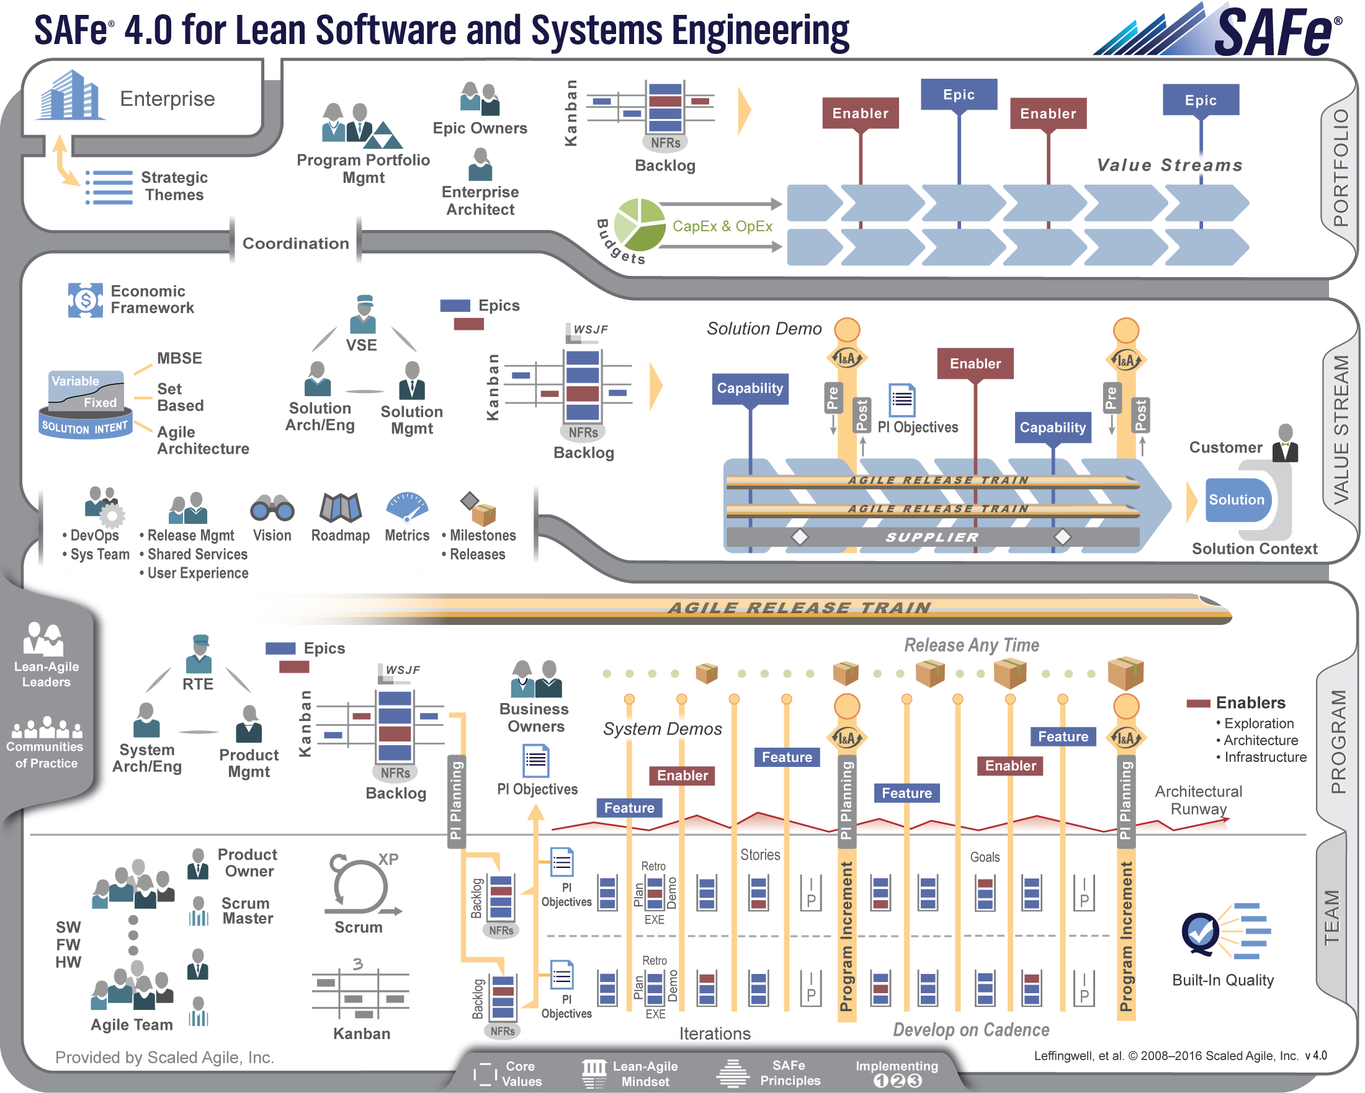

Slide 33
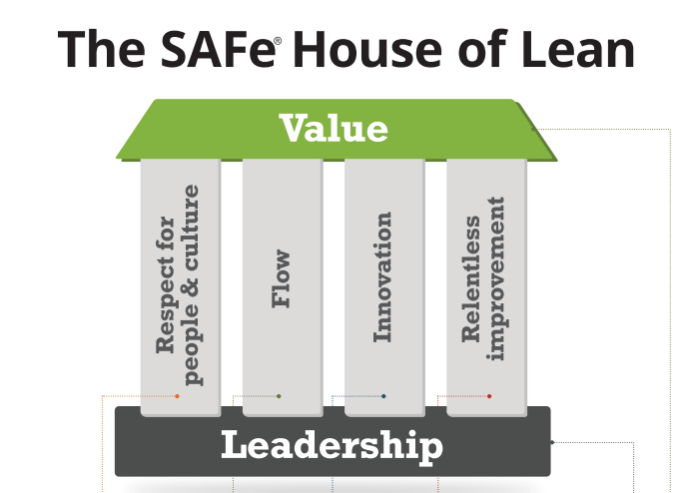
A fundamental Lean highlights
People DO all the work / don’t overload the system.
Don’t Make them Wait.
Build-in Quality
Exploit & manage Variability
Producers innovate / Consumers Validate
Reflect @ key milestones , sense of danger.

Slide 34
The Backlog

Slide 35
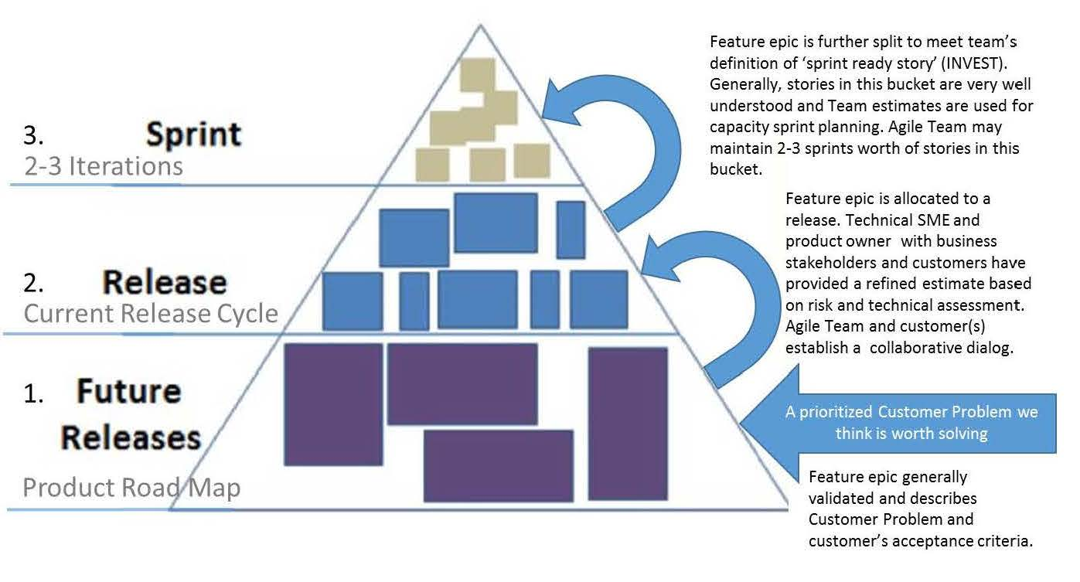
Product backlog Iceberg

Slide 36
User Story
User stories are short, simple descriptions of a feature told from the perspective of the person who desires the new capability, usually a user or customer of the system.
They typically follow a simple template:
As a <type of user>, I want <some goal> so that <some reason>.
Card, Conversation, Confirmation"; this formula (from Ron Jeffries) captures the components of a User Story:
a "Card" (or often a Post-It note), a physical token giving tangible and durable form to what would otherwise only be an abstraction:
a "conversation" taking place at different time and places during a project between the various people concerned by a given feature of a software product: customers, users, developers, testers; this conversation is largely verbal but most often supplemented by documentation;
the "confirmation", finally, the more formal the better, that the objectives the conversation revolved around have been reached.

Slide 37

INVEST Principle
The test for determining whether or not a story is well understood and ready for the team to begin
working on it is the INVEST acronym:
I – Independent
The solution can be implemented by the team independently of other stories. The team should be expected to break technical dependencies as often as possible – this may take some creative thinking and problem solving as well as the Agile technical practices such as refactoring.
N – Negotiable
The scope of work should have some flex and not be pinned down like a traditional requirements specification. As well, the solution for the story is not prescribed by the story and is open to discussion and collaboration, with the final decision for technical implementation being reserved for the Development Team.
V – Valuable
The business value of the story, the “why”, should be clearly understood by all. Note that the “why” does not necessarily need to be from the perspective of the user. “Why” can address a business need of the customer without necessarily providing a direct, valuable result to the end user. All stories should be connected to clear business goals. This does not mean that a single user story needs to be a marketable feature on its own.

Slide 38
INVEST contd….
– Estimable
The team should understand the story well enough to be able estimate the complexity of the work and the effort required to deliver the story as a potentially shippable increment of functionality. This does not mean that the team needs to understand all the details of implementation in order to estimate the user story.
S – Small
The item should be small enough that the team can deliver a potentially shippable increment of functionality within a single Sprint. In fact, this should be considered as the maximum size allowable for any Product Backlog Item as it gets close to the top of the Product Backlog. This is part of the concept of Product Backlog refinement that is an ongoing aspect of the work of the Scrum Team.
T – Testable
Everyone should understand and agree on how the completion of the story will be verified. The definition of “done” is one way of establishing this. If everyone agrees that the story can be implemented in a way that satisfies the current definition of “done” in a single Sprint and this definition of “done” includes some kind of user acceptance test, then the story can be considered testable.

Slide 39
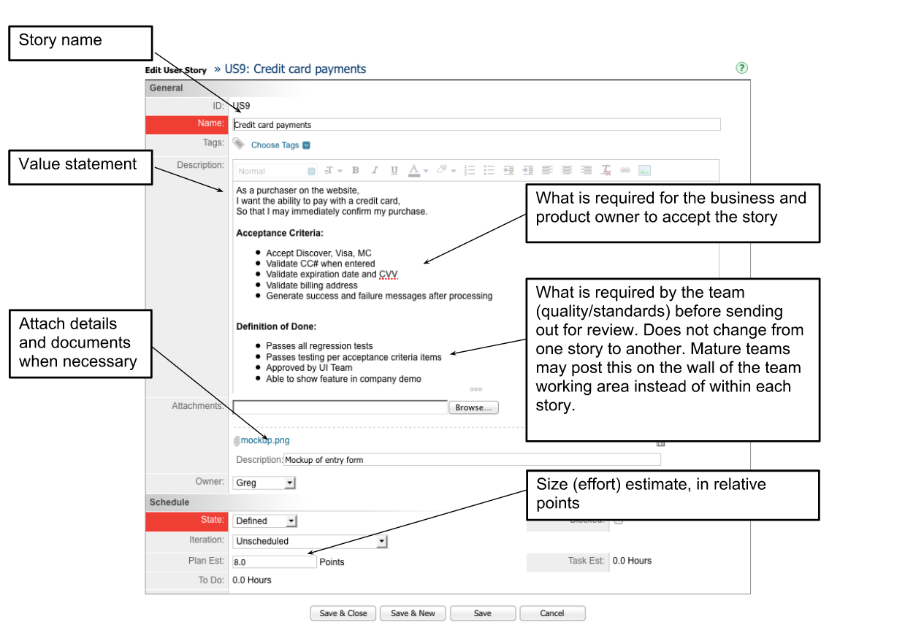
User Story Screen Shot

Slide 40
Acceptance Criteria – An Example
Consider this user story
As an Administrator, I want to be able to create User Accounts so that I can grant users access to the system
If I am an Administrator, I can create User Accounts.
I can create a User Account by entering the following information about the User: a. Name, b. Email address, c. Phone Number d. License Number (Power/Basic/None), e. Account Status (Active/Inactive), f. Reports to (from a list of "Active" Users)
I cannot assign a new User to report to an “Inactive” User
I cannot assign a new User to report to a User if it creates a cyclical relationship (e.g., User 1 reports to User 2 who reports to User 1
The system notifies me that it sent an email to the new User's email address, containing a system-generated initial password and instructions for the person to log in and change their password.
I am able to verify with the intended recipient of the email that it was received.

Slide 41
User Story Acceptance Criteria
Acceptance criteria define the boundaries of a user story, and are used to confirm when a story is completed and working as intended
A set of statements, each with a clear pass/fail result
Specify functional (e.g., minimal marketable functionality) requirements
Specify non-functional (e.g., minimal quality) requirements applicable at the current stage of project integration.
These requirements represent “conditions of satisfaction.”
There is no partial acceptance: either a criterion is met or it is not

Slide 42
Managing the sprint backlog
Individuals sign up for work of their own choosing
Work is never assigned
Estimated work remaining is updated daily
Any team member can add, delete or change the sprint backlog provided it DOES NOT impact the sprint goal.
If work is unclear, define a sprint backlog item with a larger amount of time and break it down later
Update work remaining as more becomes known.
Any team member can add, delete or change the sprint backlog
Work for the sprint emerges
If work is unclear, define a sprint backlog item with a larger amount of time and break it down later
Update work remaining as more becomes known

Slide 43
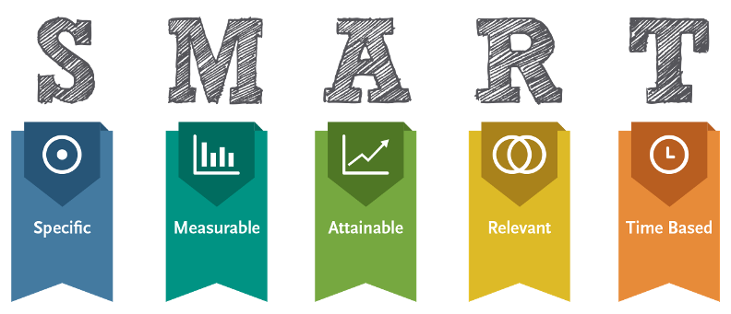
S for specific: during each sprint planning, the team agrees on a specific set of tasks to achieve, and commits to doing them. The tasks (and the user stories), answer the questions of what do I want to accomplish, purposes/benefits of accomplishing the goal, who is involved, where it takes place, and constraints.
M for measurable: the list of these tasks, plus the movement of the tickets throughout the sprint, from development to code review to QA to release (or whatever your flow is), answers the questions of how much work and when will it be accomplished.
A for attainable: functioning Agile groups don't typically commit to something in the planning stage unless it is clearly attainable -- all the pieces are there to know how to accomplish it
R for relevant: questions like is it worthwhile, is it the right time, does it match our other efforts -- stories and tasks don't get pulled into a sprint, and committed to, unless the answer is yes to all these questions (typically...YMMV)
T for time-bound: a sprint is necessarily time-bound, be it 2 weeks, 3 weeks, more, or less.

Slide 44
Scrum Roles & Ways of Working

Slide 45
Scrum framework
Roles
Product owner
Scrum Master
Team
Ceremonies
Sprint planning
Sprint review
Sprint retrospective
Daily scrum meeting
Artifacts
Product backlog
Sprint backlog
Burndown charts

Slide 46
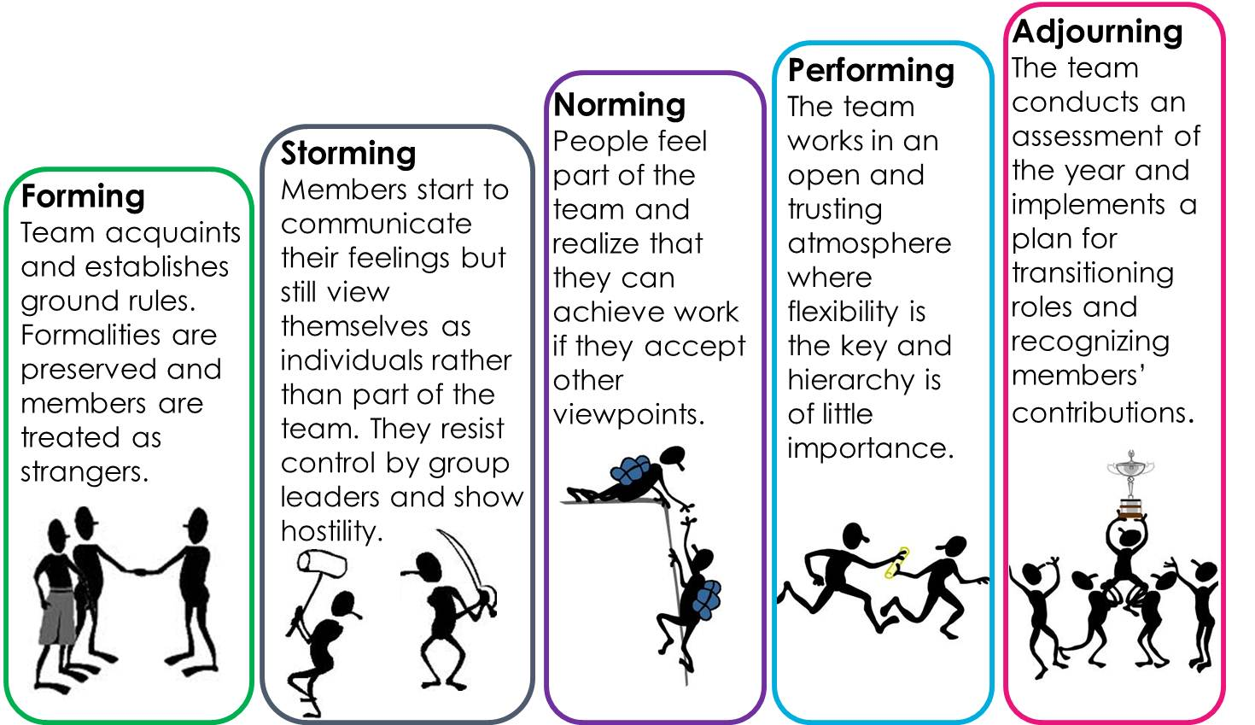

Development Sequence in Small-Groups

Slide 47
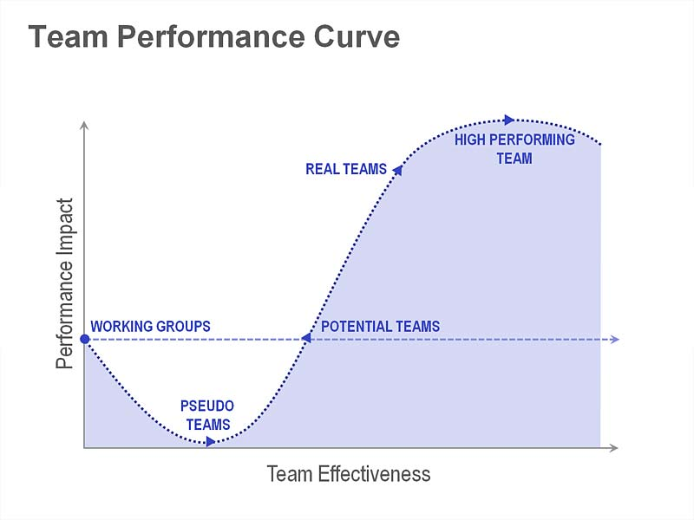
Road To Self Organization

Slide 48

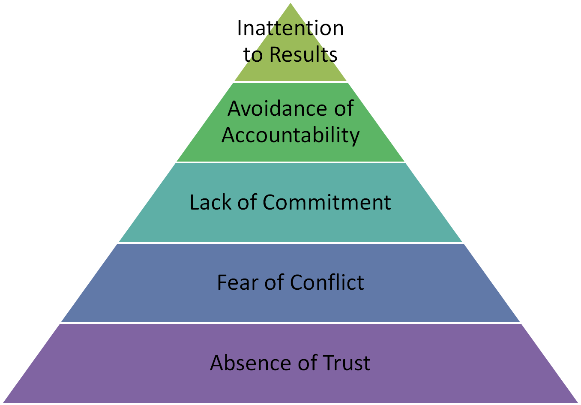
The Five Dysfunctions of a Team
Focusing on personal success, status and ego before team success
Ducking the responsibility to call peers on counterproductive behavior which sets low standards
Feigning buy-in for group decisions creates ambiguity throughout the organization
Describes the many pitfalls that teams face as they seek to "row together” – Patrick lencioni
Seeking artificial harmony over constructive passionate debate
Unwilling to be vulnerable within the group

Slide 49
Waterfall vs. Agile Roles
Scrum Team

Slide 50
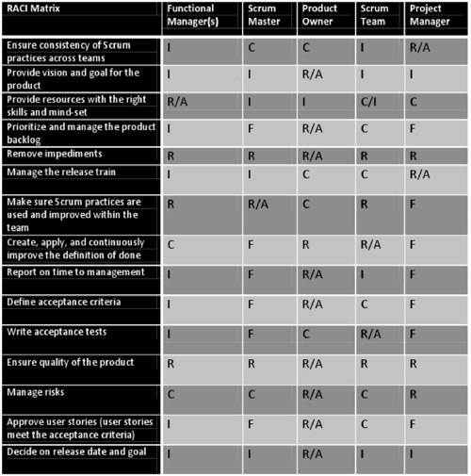
RACI Matrix
Why RACI?
Ensure consistency of Scrum practices across teams
Provide vision and goal for the product
Provide resources with the right skills and mind-set
Prioritize and manage the product backlog
Remove impediments
Make sure Scrum practices are used and improved within the team
Define acceptance criteria Write acceptance tests Ensure quality of the product Manage risks
Decide on release date and goal
R-Responsible
A-Accountable
C-Consulted
I-Informed
F- Facilitate

Slide 51

Voice of the Customer
Define the features of the product
Decide on release date and content
Be responsible for the profitability of the product (ROI)
Prioritize Epics> features according to market value
Adjust features and priority every iteration, as needed
Accept or reject work results
Product Owner

Slide 52
Be the servant leader for the team
Represents management to the project
Responsible for enacting Scrum values and practices
Removes impediments
Ensure that the team is fully functional and productive
Enable close cooperation across all roles and functions
Shield the team from external interferences
Scrum Master

Slide 53

Scrum Team
Participate in All scrum ceremonies
Responsible for the Sprint Goal
Self –Organizing
Exercise Adaptive decision making
Typically 5-9 people
Cross-functional in nature..
Programmers, QA (testers), UX designers, etc.
Members should be full-time
May be exceptions (e.g., database administrator/ Architect/QMS)

Slide 54


How do these roles communicate?
Customer
Product Owner
Scrum Team
Usually
Customer
Product Owner
Scrum Team
Recommended

Slide 55

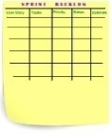




Scrum Ceremonies
Pre-Sprint Planning (_{N+1})
Sprint Planning
Daily Standup
Sprint
Review
Sprint
Retrospective
2-3W Sprint Cadence

Slide 56

All Blacks Haka
The Haka is a traditional Maori dance from New Zealand. There are thousands of Haka that are performed by various tribes and cultural groups throughout New Zealand. The best known Haka of them all is called "Ka Mate". This particular haka dates back over 200 years. A warrior chief named Te Raupahara composed it, having just escaped capture by a tribal rival. It was reflective of his relief and excitement at survival. The words, “ka mate, ka mate, ka ora, ka ora” literally means “I die, I die, I live, I live.” Te Raupahara became something of a heroic figure as a leader and a warrior and his haka was kept alive after his death.
https://www.youtube.com/watch?v=SUFsL6o8y5s
https://www.youtube.com/watch?v=tdMCAV6Yd0Y
https://www.youtube.com/watch?v=kjVqZkDZrgg

Slide 57
Ceremonies

Slide 58
Scrum framework
Roles
Product owner
ScrumMaster
Team
Ceremonies
Sprint planning
Sprint review
Sprint retrospective
Daily scrum meeting
Artifacts
Product backlog
Sprint backlog
Burndown charts

Slide 59


Team capacity
Sprint planning meeting
Sprint prioritization
Product backlog
Analyze and evaluate product backlog
Select sprint goal
Sprint
goal
Business conditions
Sprint planning
Decide how to achieve sprint goal (design)
Create sprint backlog (tasks) from product backlog items (user stories / features)
Estimate sprint backlog in hours
Current product
Sprint
backlog
Technology

Slide 60

Sprint planning
Team selects items from the product backlog they can commit to completing
Sprint backlog is created
Tasks are identified and each is estimated (1-16 hours)
Collaboratively, not done alone by the Scrum Master
High-level design is considered
As a vacation planner, I want to see photos of the hotels.
Code the middle tier (8 hours)
Code the user interface (4)
Write test fixtures (4)
Code the foo class (6)
Update performance tests (4)

Slide 61
Key Meeting Parameters
Daily
15-minutes
Stand-up
Not for problem solving
Whole world is invited
Only team members, Scrum Master, product owner, can talk
Helps avoid other unnecessary meetings

Slide 62
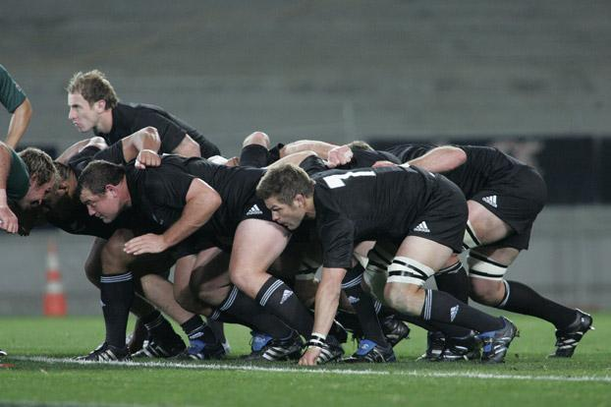

Everyone answers 3 questions
1
What did you do yesterday?
2
What will you do today?
3
Is anything in your way? Impediments
These are not status for the ScrumMaster or Management
They are commitments in front of peers

Slide 63
The sprint review ( Show/Tell)
Team presents what it accomplished during the sprint
Typically takes the form of a demo of new features or underlying architecture
Informal
2-hour prep time rule
No slides
Actual working software
Whole team participates
Invite the world

Slide 64

Continuous Improvement..
Periodically take a look at what is and is not working
Done after every sprint
Whole team participates
Scrum Master
Product owner
Team
Possibly customers and others
Whole team gathers and discusses what they’d like to: Inspect & Adapt
Start doing
Stop doing
Continue doing
This is just one of many ways to do a sprint retrospective.

Slide 65
Artifacts

Slide 66
Scrum framework
Roles
Product owner
ScrumMaster
Team
Ceremonies
Sprint planning
Sprint review
Sprint retrospective
Daily scrum meeting
Artifacts
Product backlog
Sprint backlog
Burndown charts

Slide 67
The sprint goal
A short statement of what the work will be focused on during the sprint
Life Sciences
Support features necessary for population genetics studies.
Database Application
Make the application run on SQL Server in addition to Oracle.
Financial services
Support more technical indicators than company ABC with real-time, streaming data.

Slide 68
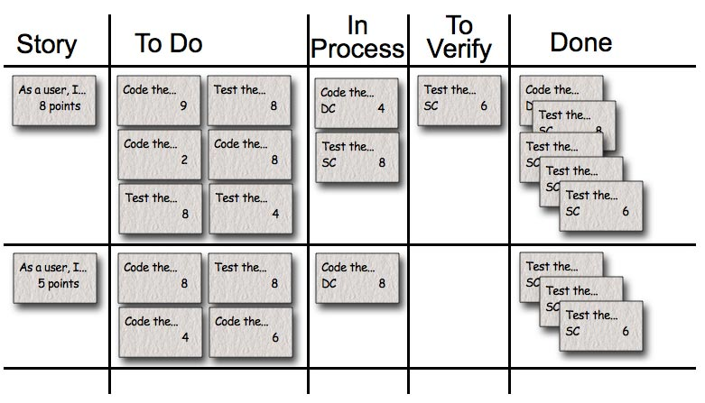
Task Board
Progress should be visible to all

Slide 69
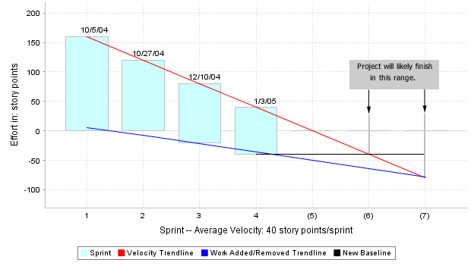
Product burndown chart
Tells Project health & likely date of completion

Slide 70
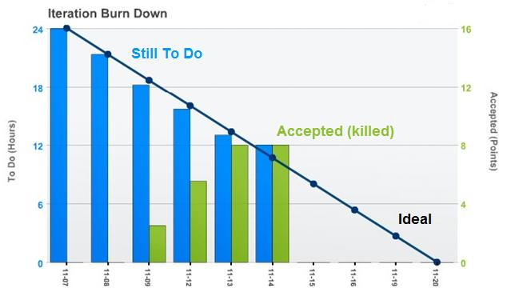
Story Acceptance

Slide 71
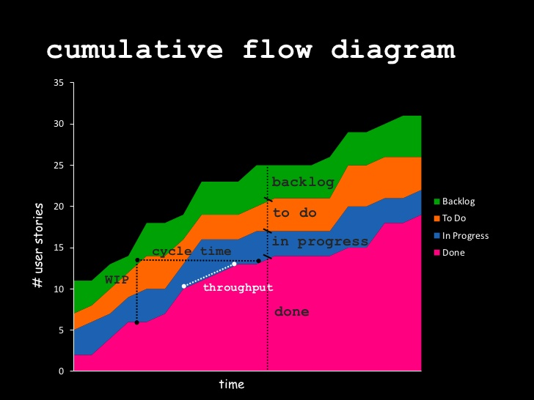
Cumulative Release Burn Up Chart
The project will be finished when the complete area merges with the not started area.
The vertical height of each area shows how much work is currently in that stage. A vertical widening of a particular area shows a bottleneck in your development process that should be investigated in case corrective action is required.
The horizontal distance from the not started line to the completed line is the projects lead time. The lead time is the average time from a feature request to a completed implementation.

Slide 72
Estimation

Slide 73


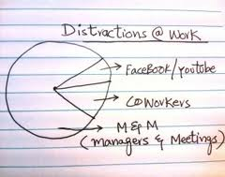
Estimation In Ideal Days
Ideal days Actual Days

Slide 74



Agile Estimation
Estimation Commitment

Slide 75

Relative Estimate
Methods to Derive Estimate
Expert Opinion
Analogy
Triangulation
Disaggregation

Slide 76




Expert Opinion

Slide 77
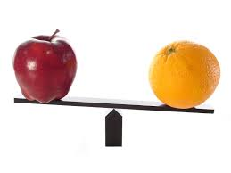
Analogy
Comparing a user story to others
“This story is like that story, so its estimate is
what that story’s estimate was.”

Slide 78
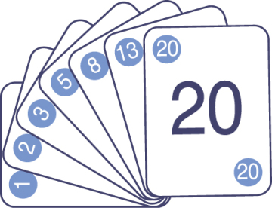
Estimate by analogy
Comparing a user story to others
“This story is like that story, so its estimate is what that story’s estimate was.”
Don’t use a single gold standard
Triangulate instead
Compare the story being estimated to multiple other stories

Slide 79
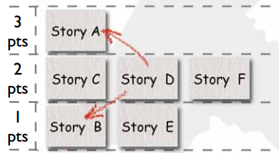
Triangulation
Story A > Story D > Story B

Slide 80

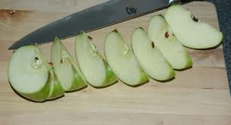
Disaggregation
Breaking a big story into smaller stories or tasks

Slide 81

Estimation Techniques
Feature Point Estimation
User Story Points
Ideal Days
Dog Sizes
T-shirt Sizing

Slide 82
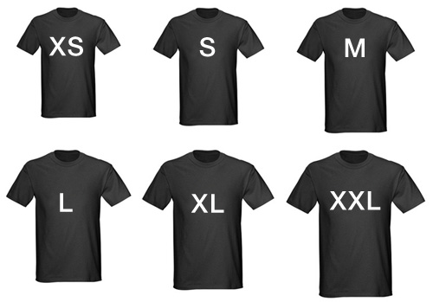
Feature Point Estimation
T-shirt Sizing
At Higher level estimate features
Assign points to features

Slide 83
Dog Sizes
Labrador Retriever
Great Dane
Chihuahua
German Shepherd
St. Bernard
Bulldog

Slide 84
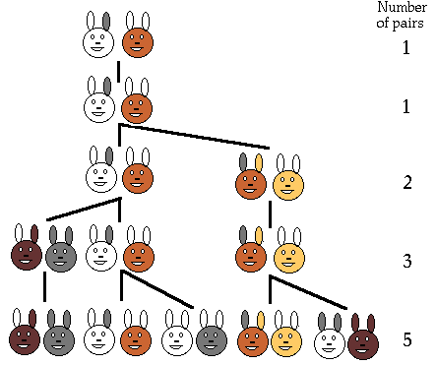
Fibonacci numbers
The sequence in which each number is the sum of the two preceding numbers.
This sequence is defined by the linear recurrence equation.
The Fibonacci numbers for n=1,2 are 1, 1, 2, 3, 5, 8, 13, 21,…
Fibonacci’s book Liber Abcai asked a question involving the reproduction of a single pair of rabbits which is the basis of the Fibonacci sequence.
It was posed: Suppose a newly born pair of rabbits (a male and female) are put in a field. The rabbits are able to mate at the age of one month so that at the end of the second month a female can produce another pair of rabbits. Assuming that the rabbits never die and the female always produces a new pair every month from the second month on. How many pairs will there be in one year? (144)

Slide 85

Measures of size
Agile
Sequential
Story points
Ideal days
Lines of code
Function points

Slide 86
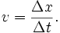
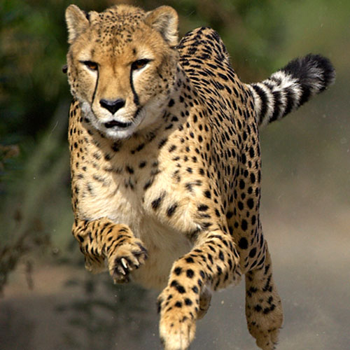
Velocity & Calculation
= Number of total story points / One iteration
Historical Data
Run 1-2 iterations
Forecast Model

Slide 87

Story points
As a user, I want to be able to have some but not all items in my cart gift wrapped.
The “bigness” of a task
Influenced by
How hard it is
How much of it there is
Relative values are what is important:
A login screen is a 2.
A search feature is an 8.
Points are unit-less

Slide 88
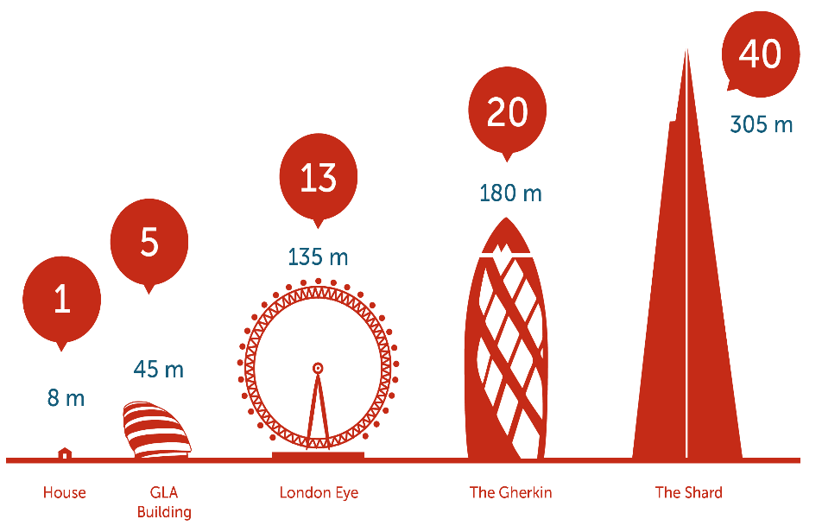
Comparing the approaches
Story points help drive cross-functional behavior
Story point estimates do not decay
Story points are a pure measure of size
Estimating in story points is typically faster
My ideal days cannot be added to your ideal days
Ideal days are easier to explain outside the team
Ideal days are easier to estimate at first
Ideal days can force companies to confront time wasting activities

Slide 89

Use the right units
Can you distinguish a 1-point story from a 2?
How about a 17 from an 18?
Use a set of numbers that make sense; I like:
1, 2, 3, 5, 8, 13
Stay mostly in a 1-10 range
Nature agrees:
Musical tones and volume are distinguishable on a logarithmic scale
Use 0 and ½ if you like

Slide 90

Planning poker
An iterative approach to estimating
Steps
Each estimator is given a deck of cards, each card has a valid estimate written on it
Customer/Product owner reads a story and it’s discussed briefly
Each estimator selects a card that’s his or her estimate
Cards are turned over so all can see them
Discuss differences (especially outliers)
Re-estimate until estimates converge

Slide 91

Planning poker—an example
Estimator
Round 1
Round 2
Jean-Luc
3
5
Xavier Rouault
8
5
Sylvain Vernier
2
5
Rene
5
8

Slide 92
Release Planning

Slide 93
Projections based on velocity
40
Mean (Best 3) = 37
Mean (Last 8) = 33
30
Mean (Worst 3) = 28
20
10
0
1
2
3
4
5
6
7
8
9

Slide 94

Extrapolate from velocity
Assume 5 sprints left
At our slowest velocity, we’ll end here (5 × 28)
At our average velocity, we’ll end here (5 × 33)
At our average velocity, we’ll end here (5 × 37)

Slide 95
Fixed-date planning
How much can I get by <date>?
Determine how many sprints you have
Estimate velocity as a range
Multiply low velocity × number of sprints
Count off that many points; These are “Will Have” items
Multiply high velocity × number of sprints
Count off that many more points; these are “might haves”

Slide 96
Fixed-date planning example
Desired release date
30 June
Will have
Today’s date
1 January
6 × 15
Number of sprints
6 (monthly)
Might have
Low velocity
15
6 × 20
High velocity
20
Won’t have

Slide 97



Three issues
Estimation in a common unit
Sprint planning
Dependencies

Slide 98
Establish a common baseline
All teams should agree on story points or ideal days
Establish a common baseline
Select a dozen or so user stories that were done recently or are on the product backlog
Estimate them en masse with Planning Poker

Slide 99

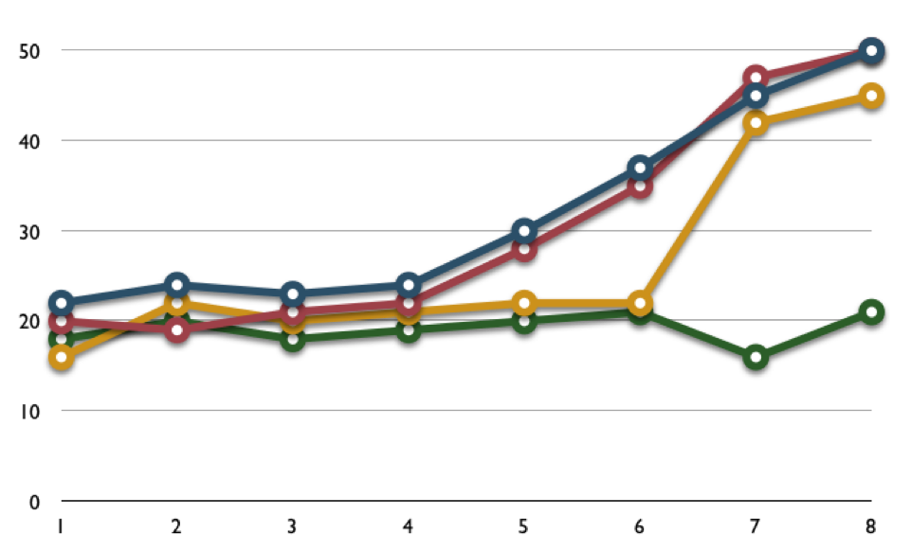
Be careful with cross-team comparisons
When did this firm start comparing velocity?
When did the yellow team figure out they were being compared?

Slide 100
Two Approaches to Sprint Planning
Stagger by a day
Sprints end by ± a day
Helps a key resource (e.g., a product owner or architect) fully participate in many planning meetings

Slide 101
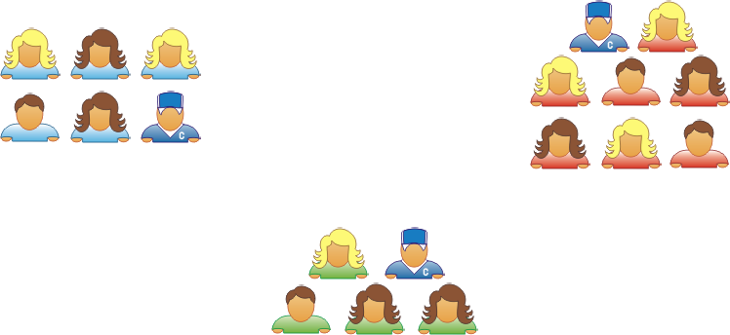

The Big Room
All sprints end on same day
All planning is on same day and in one room
Key resources shift between teams on demand

Slide 102

Dependencies
After Sprint 1
Must be done in this order and likely to influence overall ship date
Fewer of these than you may think
Emergent dependencies
“OK, we’re going to start on such-and-such soon. As you know we need this-and-that first.”
Sprint 1
Sprint 2
Sprint 3
Sprints 4−7
Code… 8
Test… 4
Design 4
Code… 5
While planning Sprint 2, a team rolls Sprint 4 into view.
They discover a dependency on another team.
The other team work on that item during Sprint 3.
After Sprint 2
Sprint 2
Sprint 3
Sprint 4
Sprints 5−7
Code… 3
Test… 7
Test… 6
Code… 8

Slide 103


Buffer critical dependencies
Sprint 1
Sprint 2
Sprint 3
20 points
10 points
20 points
Sprint 1
Sprint 2
Sprint 3
17 points
17 points
17 points

Slide 104

Rolling lookahead planning
Task
Hours
Code the …
8
Sprint 1
Test the …
16
Integrate with …
5
Code the …
8
Design the …
4
Sprint 2
Sprint 3

Slide 105
Calling it ‘Done’

Slide 106
Definition of Done
Am I finished with a feature?
You are not finished with a feature until it meets the benchmark defined by done. A very simple definition of done can be encapsulated as follows:
Code Complete
Test Complete
Approved by Product Owner

Slide 107
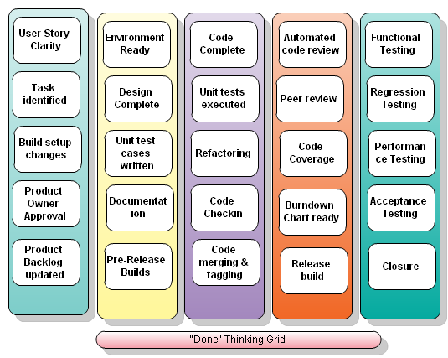
Definition of Done
A potentially shippable product is one that has been designed, developed and tested and is therefore ready for distribution to anyone in the company for review or even to any external stakeholder. Adhering to a list of “done” criteria ensures that the sprint product is truly shippable.

Slide 108
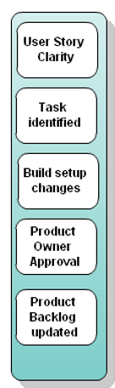
Column 1
Definition of Done
User Story Clarity User stories selected for the sprint are complete with respect to product theme, understood by the team, and have been validated by the detailed acceptance criteria.
Tasks Identified Tasks for selected user stories have been identified and estimated by the team.
These first two topics are typically covered in the sprint planning meeting but are mentioned as done criteria for the sake of verification.
Build and package changes Build and package changes have been communicated to the build master. These changes have been implemented, tested and documented to ensure that they cover the features of the sprint.
Product owner approval Each finished user story has been passed through UAT (User Acceptance Testing) and signed off as meeting requirements
Updating Product Backlog All features not done during the sprint are added back to the product backlog. All incidents/defects not handled during the sprint are added to the product backlog.

Slide 109
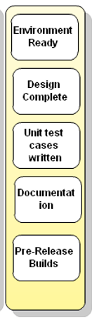
Column 2
Definition of Done
Environment ready
Development environment is ready with all third-party tools configured.
Staging environment is ready.
Continuous integration framework is in place. The build engine is configured to schedule hourly, nightly, and release builds.
Desired build automation is in place. Why "desired"? Because there is no end to build automation :)
Test data for the selected features has been created
Design complete Design analysis is complete as per the user story or theme. UML diagrams are either created or updated for the feature under development. You might need to prototype various components to ensure that they work together. Wireframes and prototype have been created and approved by the respective stakeholders.
Unit test cases written Unit test cases have been written for the features to be developed.
Documentation Ready Documentation (Just enough or whatever the team agrees to) to support the sprint demo is ready

Slide 110
Column 2
Definition of Done
Pre-Release builds
Pre release builds (hourly/nightly) have been happening and nightly build reports have been published on regular basis. The following could/should be part of pre-release builds:
Compile and execute unit test cases (mandatory)
Creation of cross reference of source code
Execution of automated code reviews for verification of coding rules
Code coverage reports are generated
Detection of duplicate source code
Dependency analysis and generation of design quality matrix (static analysis, cyclomatic complexity)
Auto deployment in staging environment
It comes down to build automation; there is no end to what can be achieved from automated hourly, nightly builds. The team along with the product owner needs to decide on how much build automation is required.

Slide 111
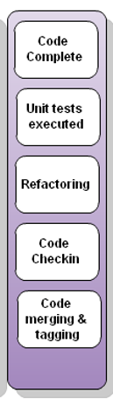
Column 3
Definition of Done
Code Complete Source code changes are done for all the features in the “to do” list.” Source code has been commented appropriately.
Unit testing is done Unit test cases have been executed and are working successfully
Code Refactoring Source code has been refactored to make it comprehensive, maintainable and, amenable to change.
A common mistake is to not keep refactoring in the definition of done. If not taken seriously, refactoring normally spills out to next sprint or, worse, is completely ignored.
Code check-in Source code is checked in the code library with appropriate comments added.
If project is using tools which help in maintaining traceability between user stories and the respective source code, proper check-in guidelines are followed.
Code merging and tagging Finalized source code has been merged with the main branch and tagged appropriately (merging and tagging guidelines are to be used)

Slide 112
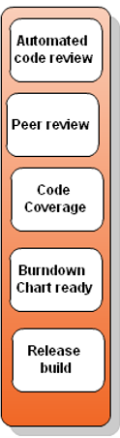
Column 4
Definition of Done
Automated Code reviews Automated code review has been completed using the supported tools/technologies. Violations have been shared with the team and the team has resolved all discrepancies to adhere to the coding standard. (Automated code reviews should be hooked up with CI builds.)
Peer reviews Peer reviews are done. If pair programming is used, a separate peer review session might not be required.
Code coverage is achieved Code coverage records for each package are available and whatever the team has decided as the minimum benchmark is achieved.
Project metrics are ready Burndown chart has been updated regularly and is up to date.
Release Build
Build and packaging A Build (successful) is done using continuous integration framework. Change log report has been generated from Code Library and Release notes have been created. Deliverables have been moved to release area.
Build deployment in staging environment Build deliverables are deployed in staging environment. If it is easy, this step should be automated.

Slide 113
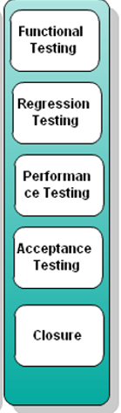
Column 5
Definition of Done
Functional testing done
Automated testing All types of automated test cases have been executed and a test report has been generated. All incidents/defects are reported.
Manual testing Quality assurance team has reviewed the reports generated from automation testing and conducted necessary manual test cases to ensure that tests are passing. All incidents/defects are reported.
Build issues If any integration or build issues are found, the necessary steps are repeated and respective “Done” points are adhered to.
Regression testing done Regression testing is done to ensure that defects have not been introduced in the unchanged area of the software.
Performance testing done A common mistake is to not keep performance testing in the definition of done. This is an important aspect. Most performance issues are design issues and are hard to fix at a later stage.
Acceptance testing done Each finished user story has been passed through UAT (User Acceptance Testing) and signed off as meeting requirements
Closure All finished user stories/tasks are marked complete/resolved. Remaining hours for task set to zero before closing the task.
Other necessary/optional activities Anything which is very specific to the project environment These might include: - Security audit sign off - Deployable on multiple platforms such as Windows, Linux

Slide 114
Testing in Agile

Slide 115
What is Quality?
“Markus Gärtner Relevance is relevance to some person, just like quality is quality to some person and hot weather is hot weather to some person.”
Value is context dependent
Testing measures that value

Slide 116
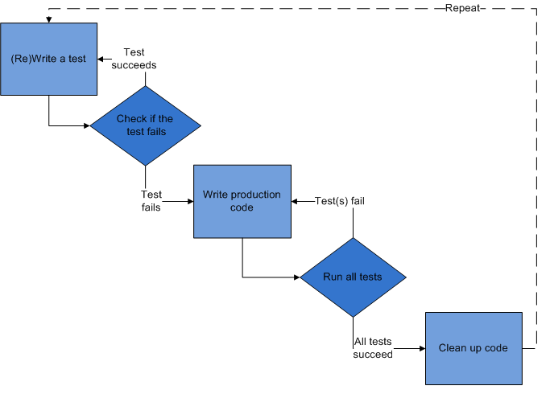
Engineering Practices - TDD
Method of development which drives the development and design by writing tests before actual implementation.
Improved productivity and quality
Better design and maintainability
Requires lot of discipline and commitment

Slide 117
Agile Testing Success Factors
Testers are part of the team
Agile testing mindset
Automate tests
Look at the big picture
Drop the “Quality Police” mindset
Automate tests wherever practical
Focus on team goals & customer value
Need rapid feedback
Balance against developer focus on technical implementation
Use agile test matrix as guide
Collective ownership
Be cathedral builders not stone cutters

Slide 118
Agile Testing Success Factors
Foundation of critical practices
Collaborate
Continually improve
Collaborate with customers
Team retrospectives
Session-based testing, agile test environments
Informative workspace
Collaborate within team
Personal training: reading, blogs, QAI, local QA groups

Slide 119
Traditional Approach - Waterfall
This is the “perceived wisdom” – the way that we have been taught.
The agile community argues that:
The cost of change curve is as much a result of the process rather than intrinsic to software development
Requirements, analysis & design should be
Requirements
Business Requirements
Technical Requirements
Analysis & Design
System Specifications
Component Specifications
Code
C#, C, C++ etc.
Test
Deploy
Big-Bang Integration
Validation Tests
Verification Tests

Slide 120
Agile Approach
Iteration 1
Requirements
Analysis & Design
Code
Test
Requirements
Analysis & Design
Code
Test
Deploy
Iteration 2
Requirements
Analysis & Design
Code
Test
Iteration 3
Requirements
Analysis & Design
Code
Test
Iteration 4
Notes:
This is the “perceived wisdom” – the way that we have been taught.
Get it right the first time.
If only we did a better job of defining requirements then …

Slide 121
Brian Marick’s Agile Testing Matrix
Q3:
Some tests in Q2 may be incorrect or incomplete
Team may misunderstand, agile customer may omit or forget something
Emulate how a real user would use the system
Manual testing – requires a human
Exploratory/session based testing
Q2: Story Driven Development
Measure “external quality” of system
Story tests drive higher level system design
Tests are more functional; more examples & combinations
Tests boundary conditions, error handling, presentation
Automate
Manual
Customer Facing
Functional Tests
Customer Tests
Story Tests/Examples
User Acceptance Tests
Exploratory Tests
Usability Tests
Unit Tests
Integration Tests
Performance Tests
Load Tests
Supports Development
Q2
Q3
Critiques Product
Q1
Q4
Q4:
Performance, robustness, security etc.
Sometimes not given enough focus on agile teams
Often requires specialized tools & expertise
Measure “internal quality” of system
Small unit tests drive design of small part of code.
Larger integration tests drive system design
Automated, in same language, done by programmers
Run often and at every checkin
Automate
Tools
Technology Facing
Notes:
* Tests on right hand side feed into stories/tasks for left hand side

Slide 122
QA Activities
Q2: Story Driven Development
Measure “external quality” of system
Story tests drive higher level system design
Tests are more functional; more examples & combinations
Tests boundary conditions, error handling, presentation
Product Owner Collaboration
Customer Collaboration
Q3:
Some tests in Q2 may be incorrect or incomplete
Team may misunderstand, agile customer may omit or forget something
Emulate how a real user would use the system
Manual testing – requires a human
Exploratory/session based testing
Customer Facing
Product Specifications
Test Ideas
Testing
UAT Design
Exploratory Testing
Usability Testing
Test Ideas
Test Development
Testing
Test Scripts
Testing
Test Analysis
Q2
Q3
Q4:
Performance, robustness, security etc.
Sometimes not given enough focus on agile teams
Often requires specialized tools & expertise
* Tests on right hand side feed into stories/tasks for left hand side
Supports Development
Critiques Product
Q1
Q4
Q1: Test Driven Development
Measure “internal quality” of system
Small unit tests drive design of small part of code.
Larger integration tests drive system design
Automated, in same language, done by programmers
Run often and at every checkin
Developer
Collaboration
IT Collaboration
Technology Facing

Slide 123
What should we test?
Goals – What should we focus on?
The Test Status Problem
A Low Tech Dashboard Solution
Find bugs fast
Fix bugs fast – through rapid testing feedback
Visibility
Transparency
Auditability
Maximize testing value
“What’s the status of testing?”
“What are you doing today?”
“When will you be finished?”
“Why is it taking so long?”
“Have you tested _______, yet?”
Report test cycle progress in a simple, structured way...
...that shows progress toward a goal...
... manages expectations...
...and inspires support...
...for an effective test process.

Slide 124
Types of Automated Tests
UI Tests
In same language as system
xUnit
Through UI
TestComplete
SilkTest
TestDirector
Functional Tests
In business language
Fit/FitNesse
Unit Tests
cost
Provides safety net
Supports rapid iterations
Provides footholds to keep notching upward
Provides rapid feedback
Focuses effort on what is valuable
Frees people to do their best work
Exploratory testing can provide immediate rapid feedback on areas not fully specified.
Automated tests provide feedback that previously validated work still works as expected
Notes:
Exploratory testing can provide immediate rapid feedback on areas not fully specified.
Automated tests provide feedback that previously validated work still works as expected

Slide 125
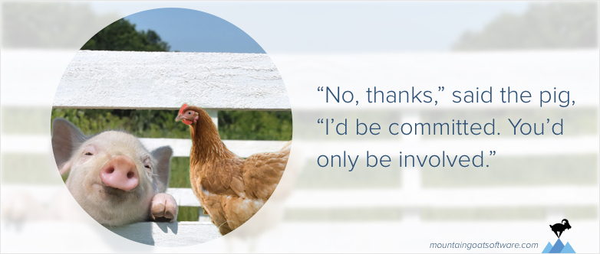
Difference Between ‘Commitment’ & being Involved
There is a story in Scrum about a chicken and a pig.
One day the chicken decides that the two should start a restaurant.
The pig is intrigued by the idea and says, “That sounds great. I’m an entrepreneurial type of hog. I’m sick of working for the farmer. But what are we going to call the restaurant?”
The chicken thinks. Then she scratches and pecks at the dirt and suggests, “Ham and Eggs!”
To which the pig replies, “No thanks, I’d be committed. You’d only be involved.”

Slide 126
Glossary of Terms
*** Please click on the PDF file for glossary of terms

Slide 127


